Slide 1
Vector Borne Diseases Mapped against Flooding and Population in USA
Anumula Naga Raviteja (12200983)
raviteja.anumula-naga@stud.th-deg.de

Slide 2
Problem Statement
Performing EDA on Project Tycho's Dengue, malaria and West Nile Virus Datasets.
Effects of Floods and Population over the number of cases in the above three vector-borne diseases over the years 2013-2017.

Slide 3
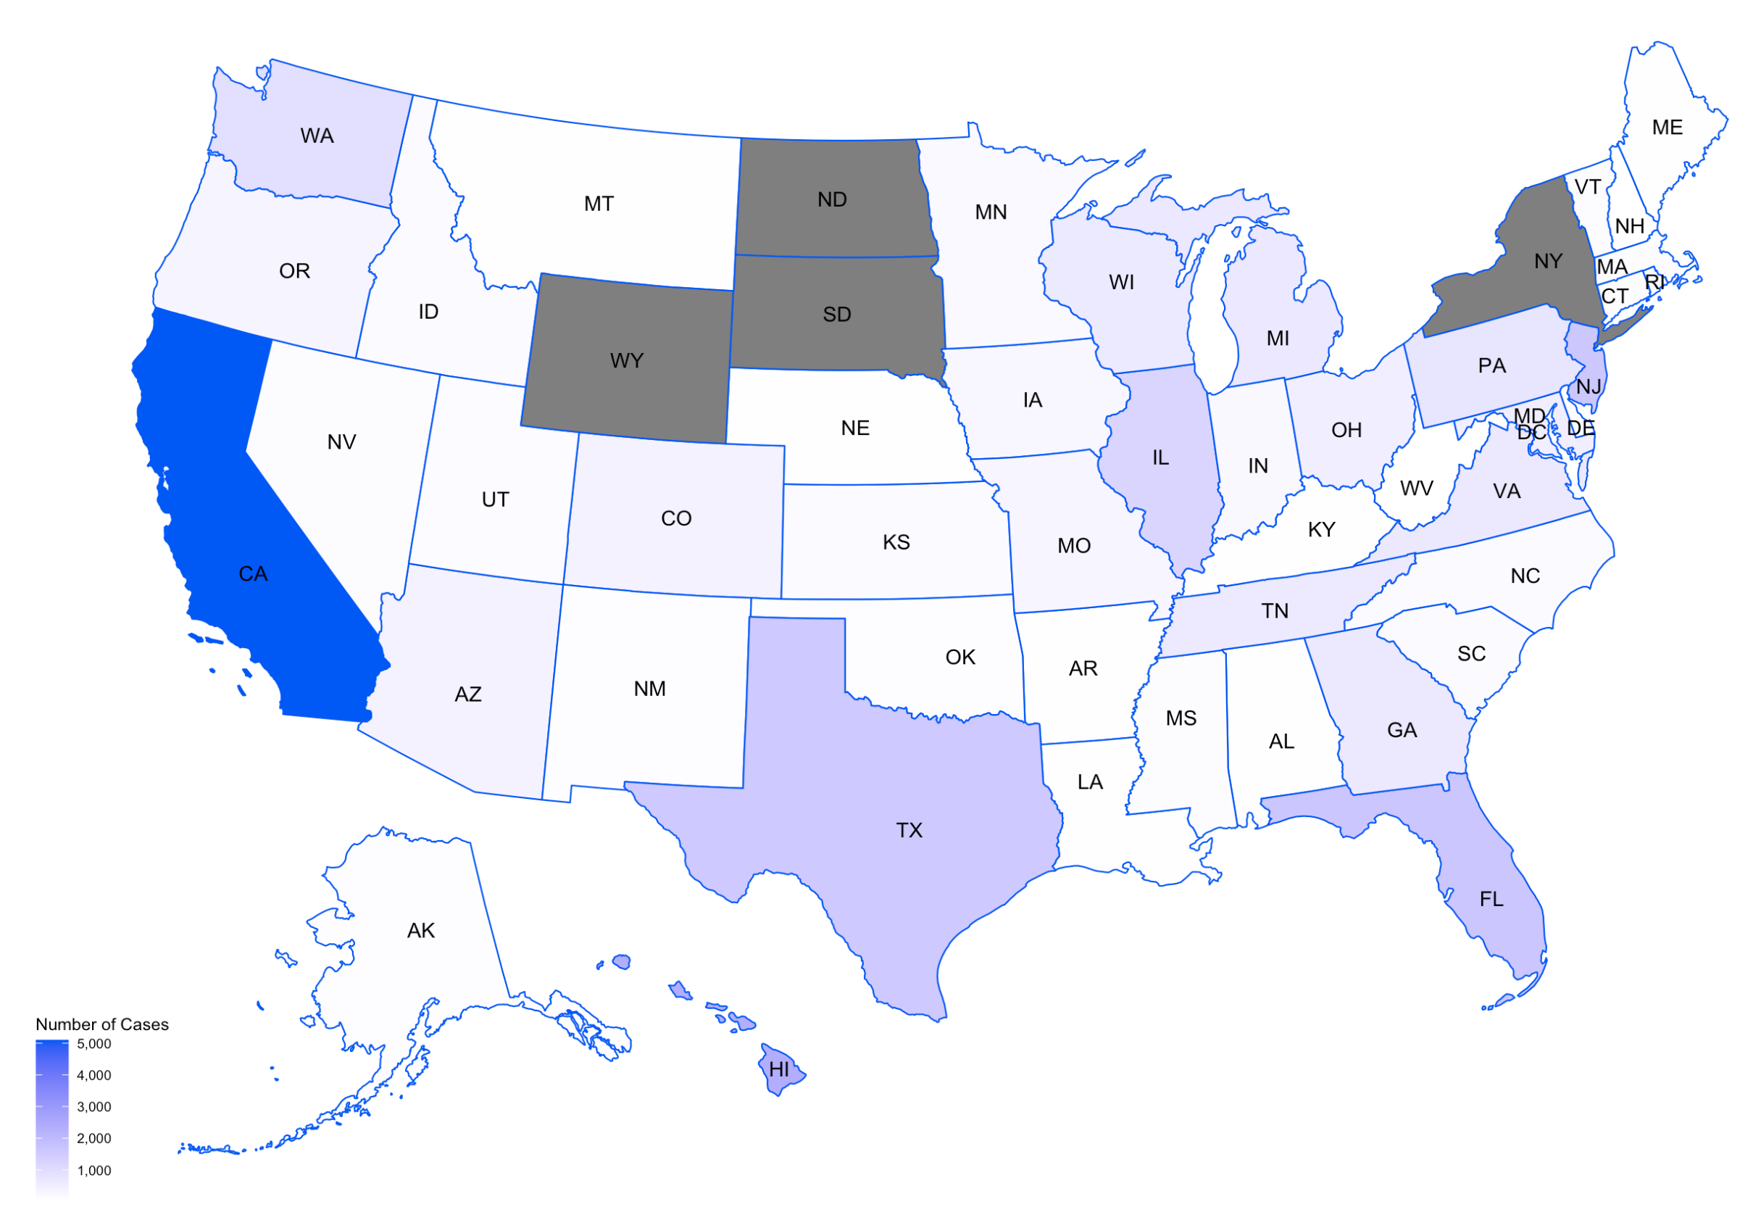
Plots
US Map of Dengue cases over the years 2013-2017

Slide 4
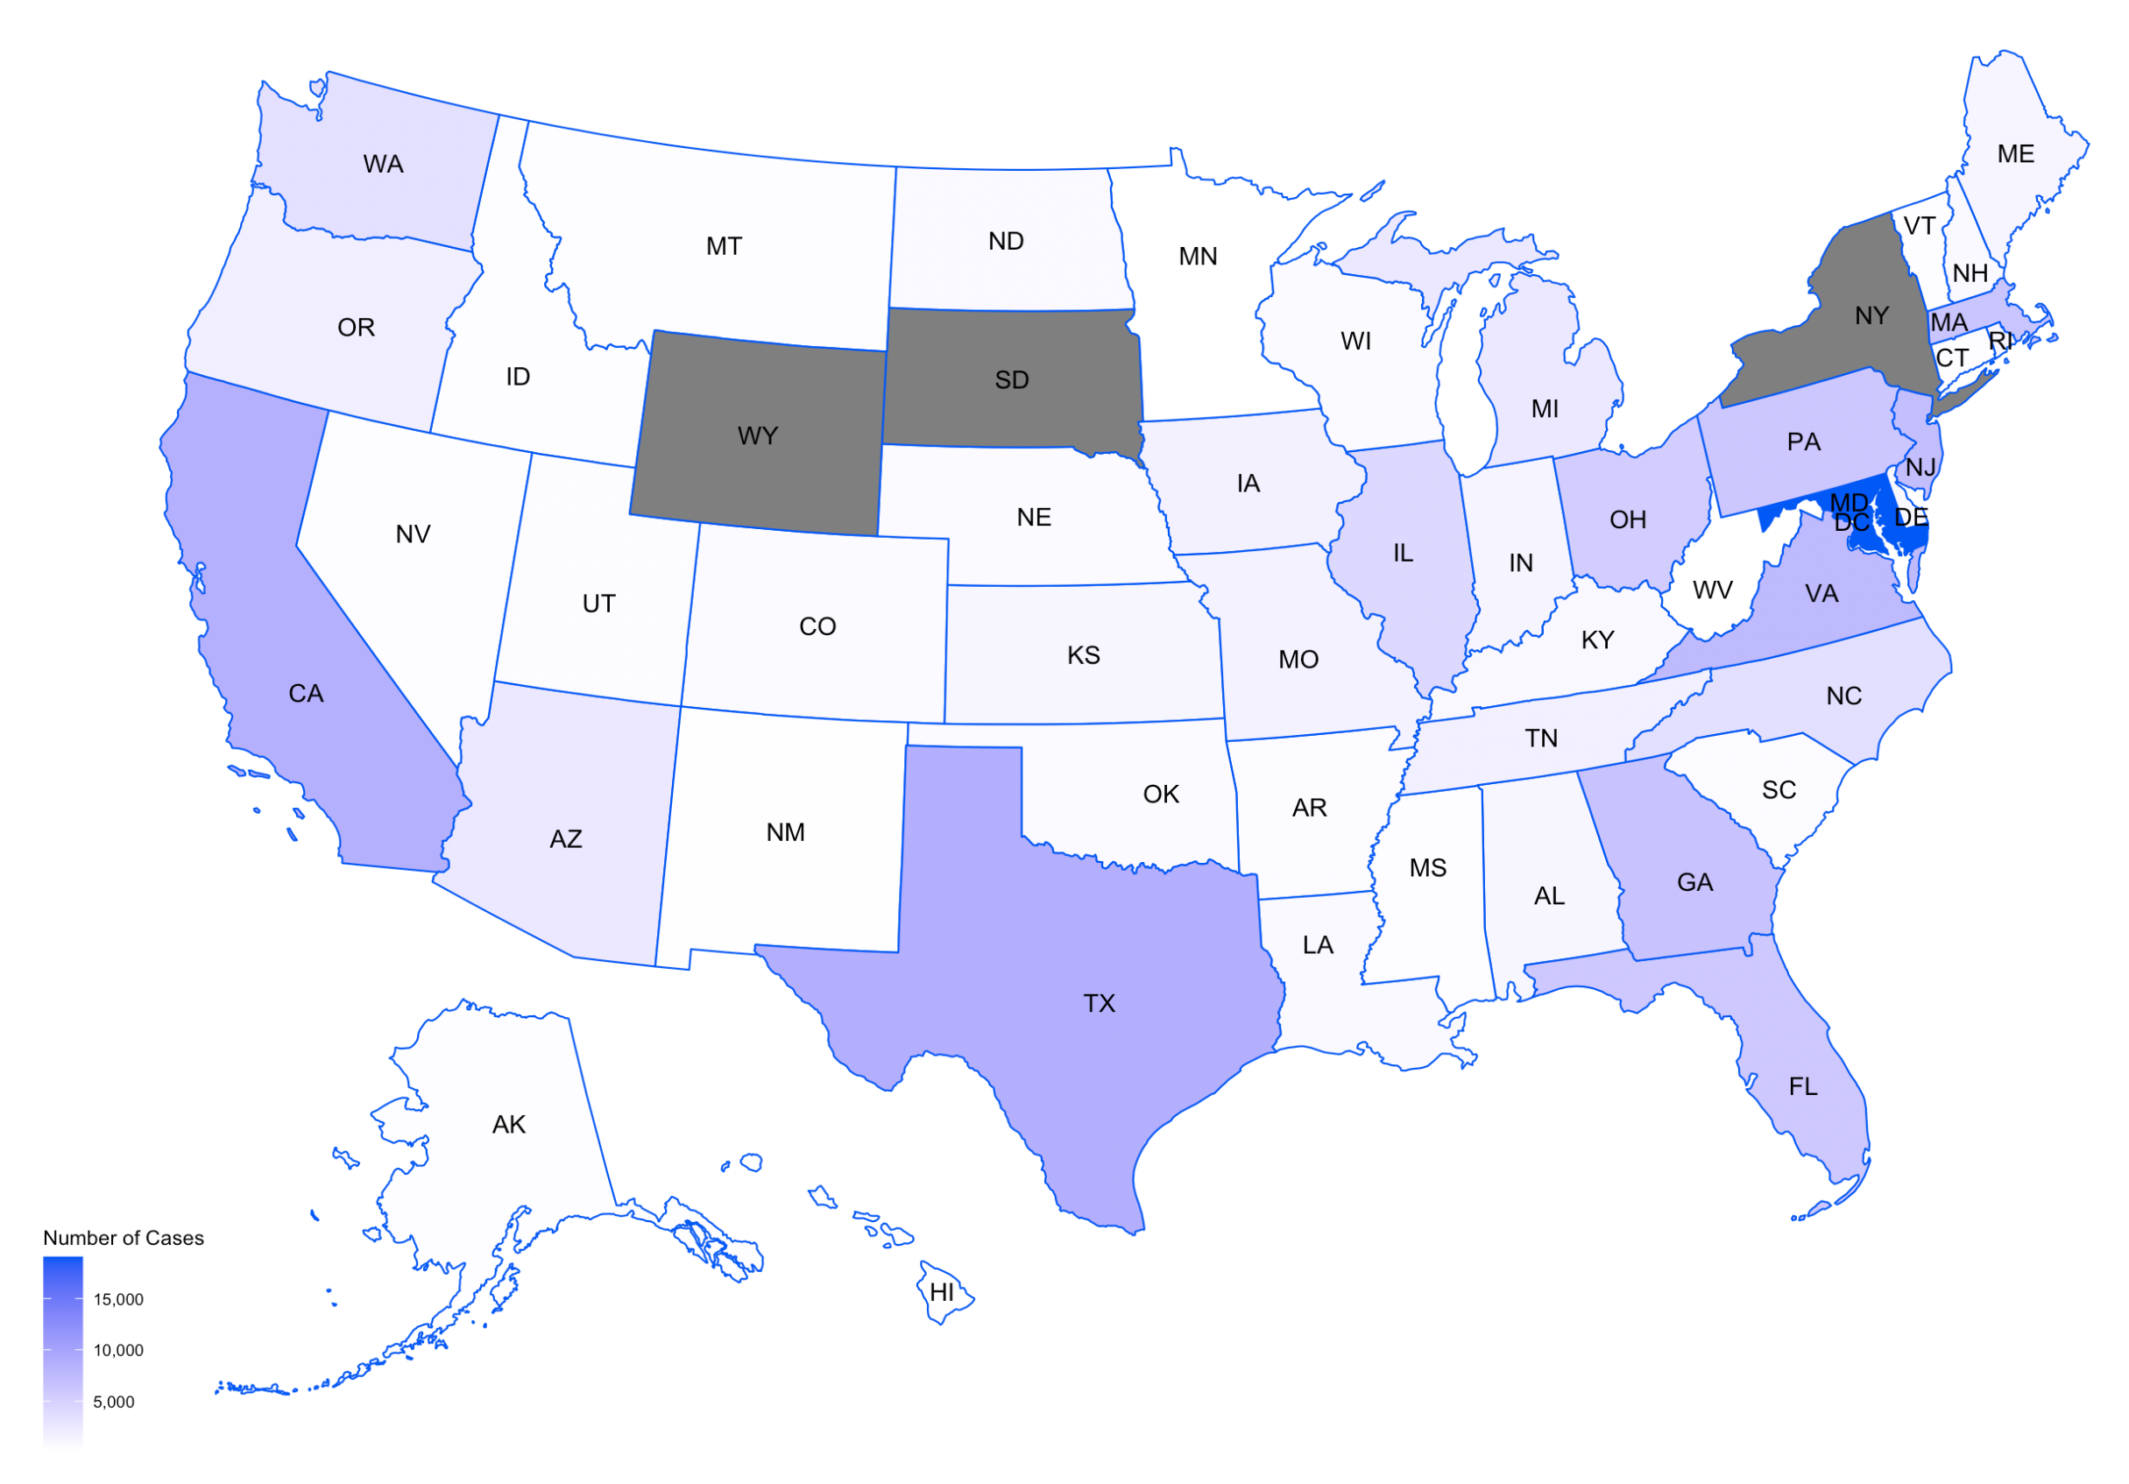
US Map of Malaria cases over the years 2013-2017

Slide 5
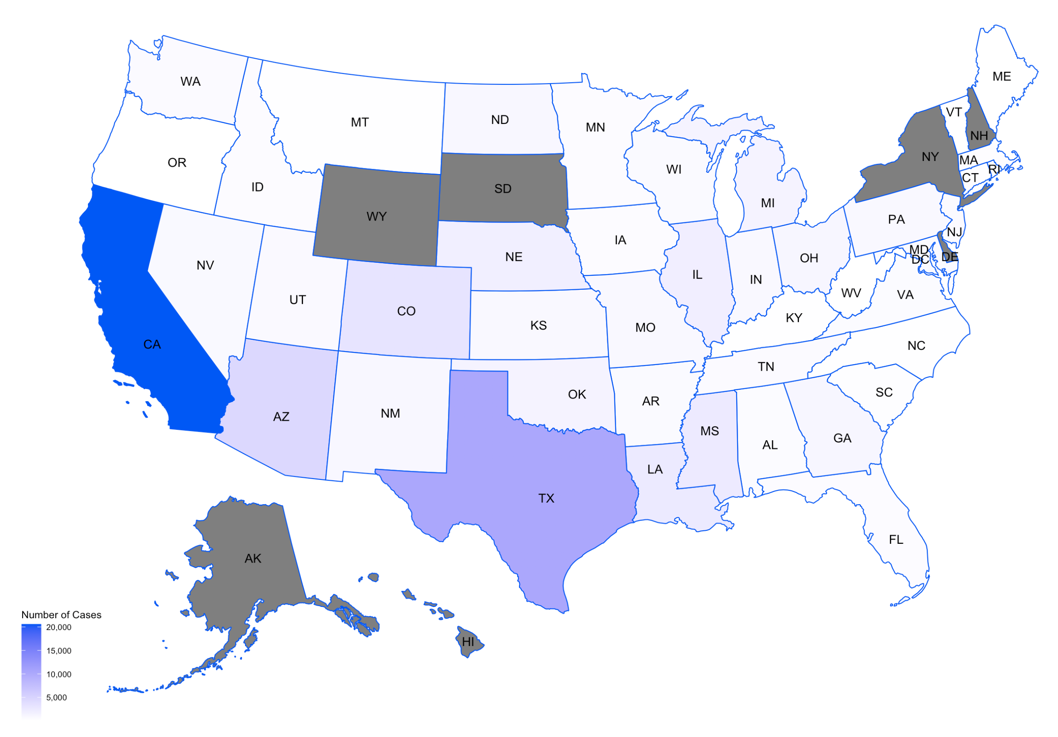
US Map of West Nile Virus cases over the years 2013-2017

Slide 6
Observations
We can observe that CA has been recorded with highest number of dengue cases followed by TX and FL.
Highest number of Malaria cases has been recorded with MD followed by its nearby region. Apart from them CA and TX also have been affected severely.
CA being the most affected by WNV followed by TX. Apart from them few cases were from AZ and CO.

Slide 7
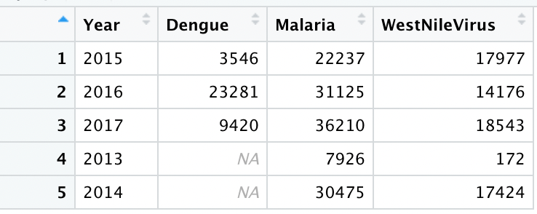
Combined data of three diseases over the years 2013-2017

Slide 8
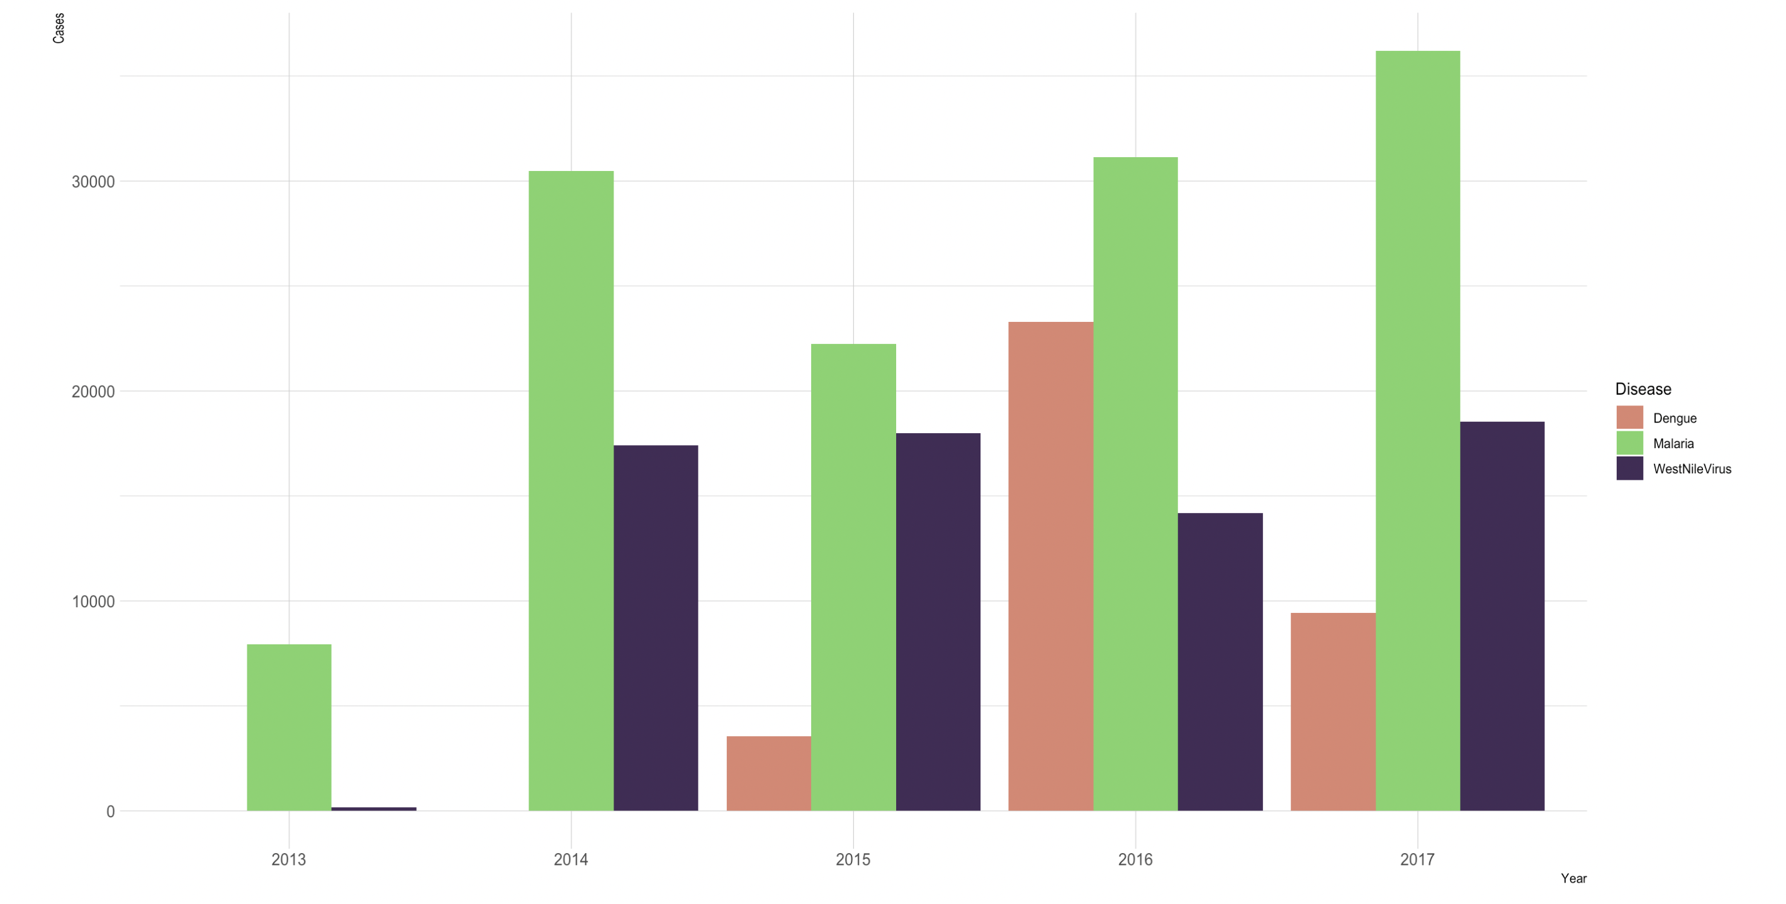
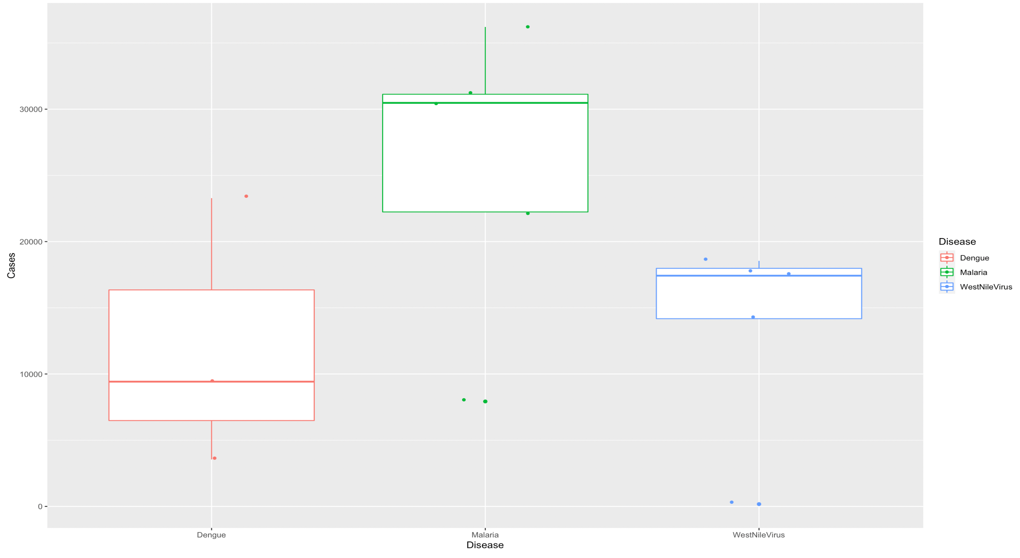
Visualizing the above table using Box Plot and Grouped Bar plots

Slide 9
Observations
From the above two plots we can see that Malaria has the most number of cases among other vector-borne diseases.

Slide 10
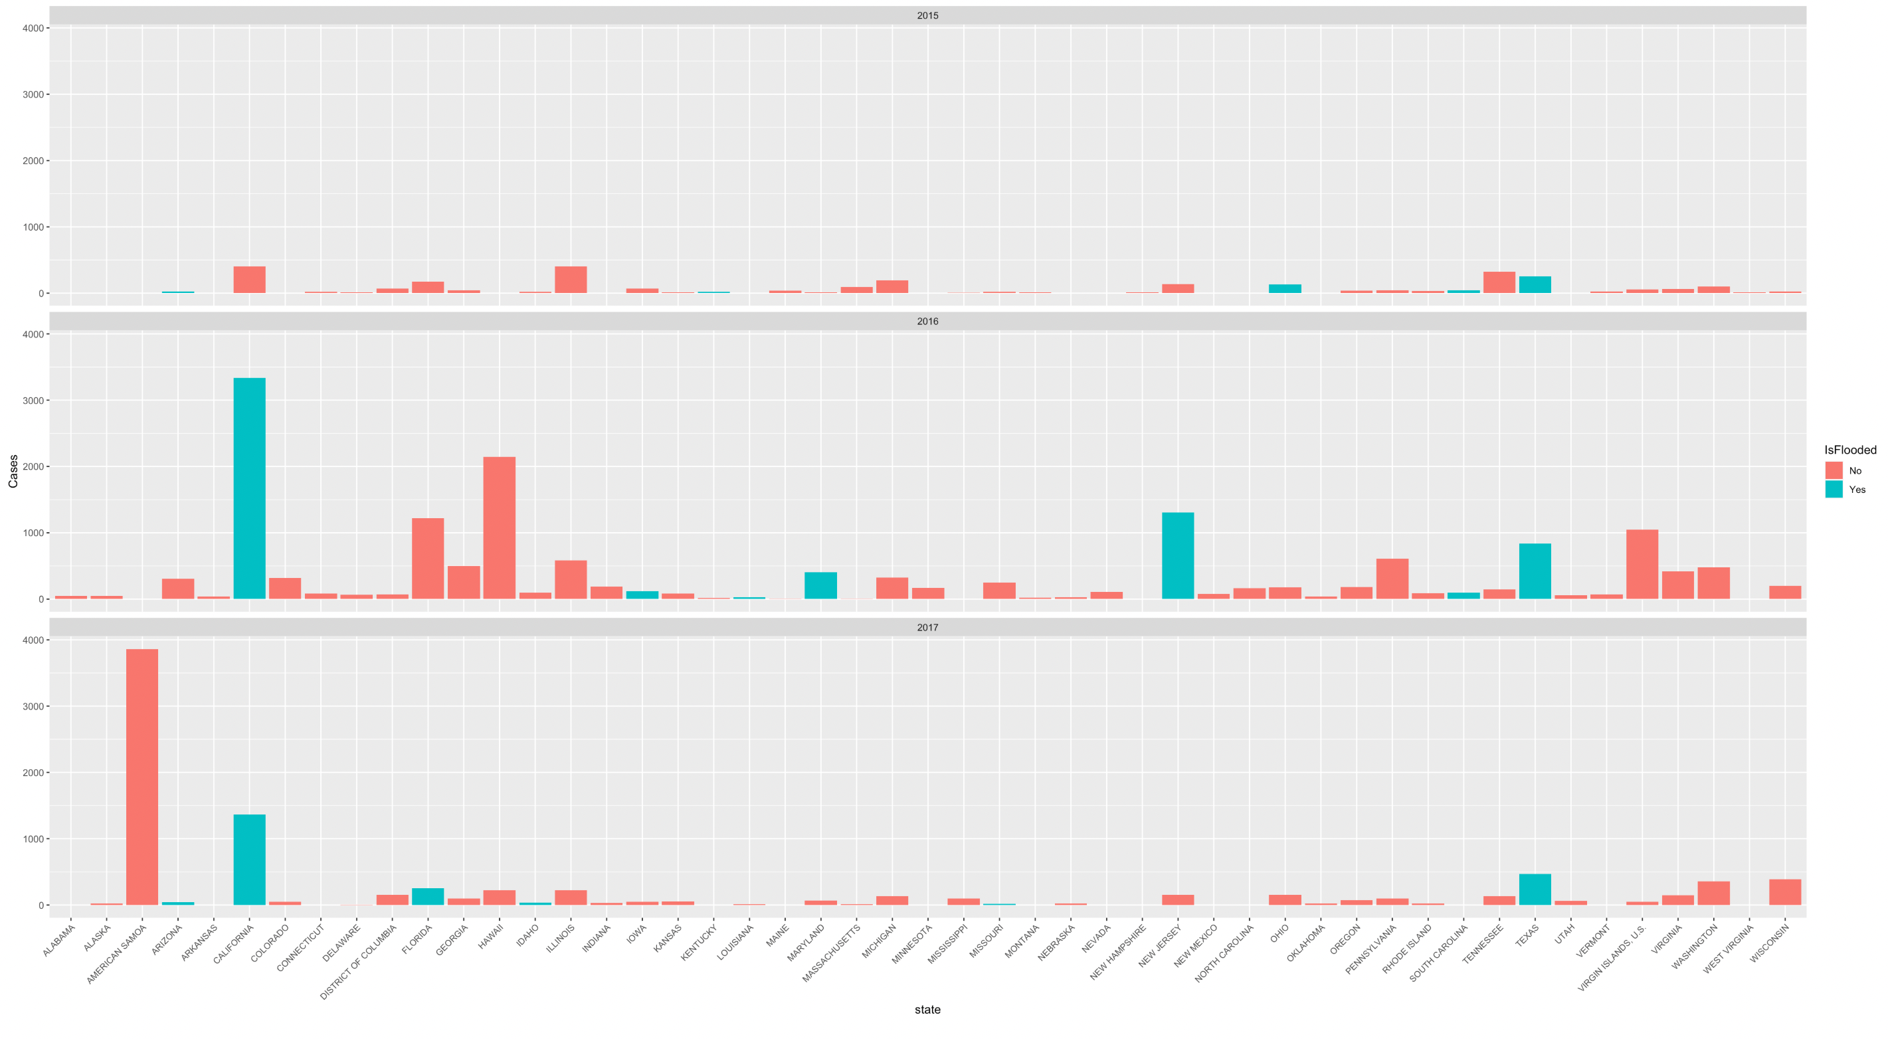
Visualizing Floods being a major factor in the increasing cases of vector-borne diseases.
Dengue

Slide 11
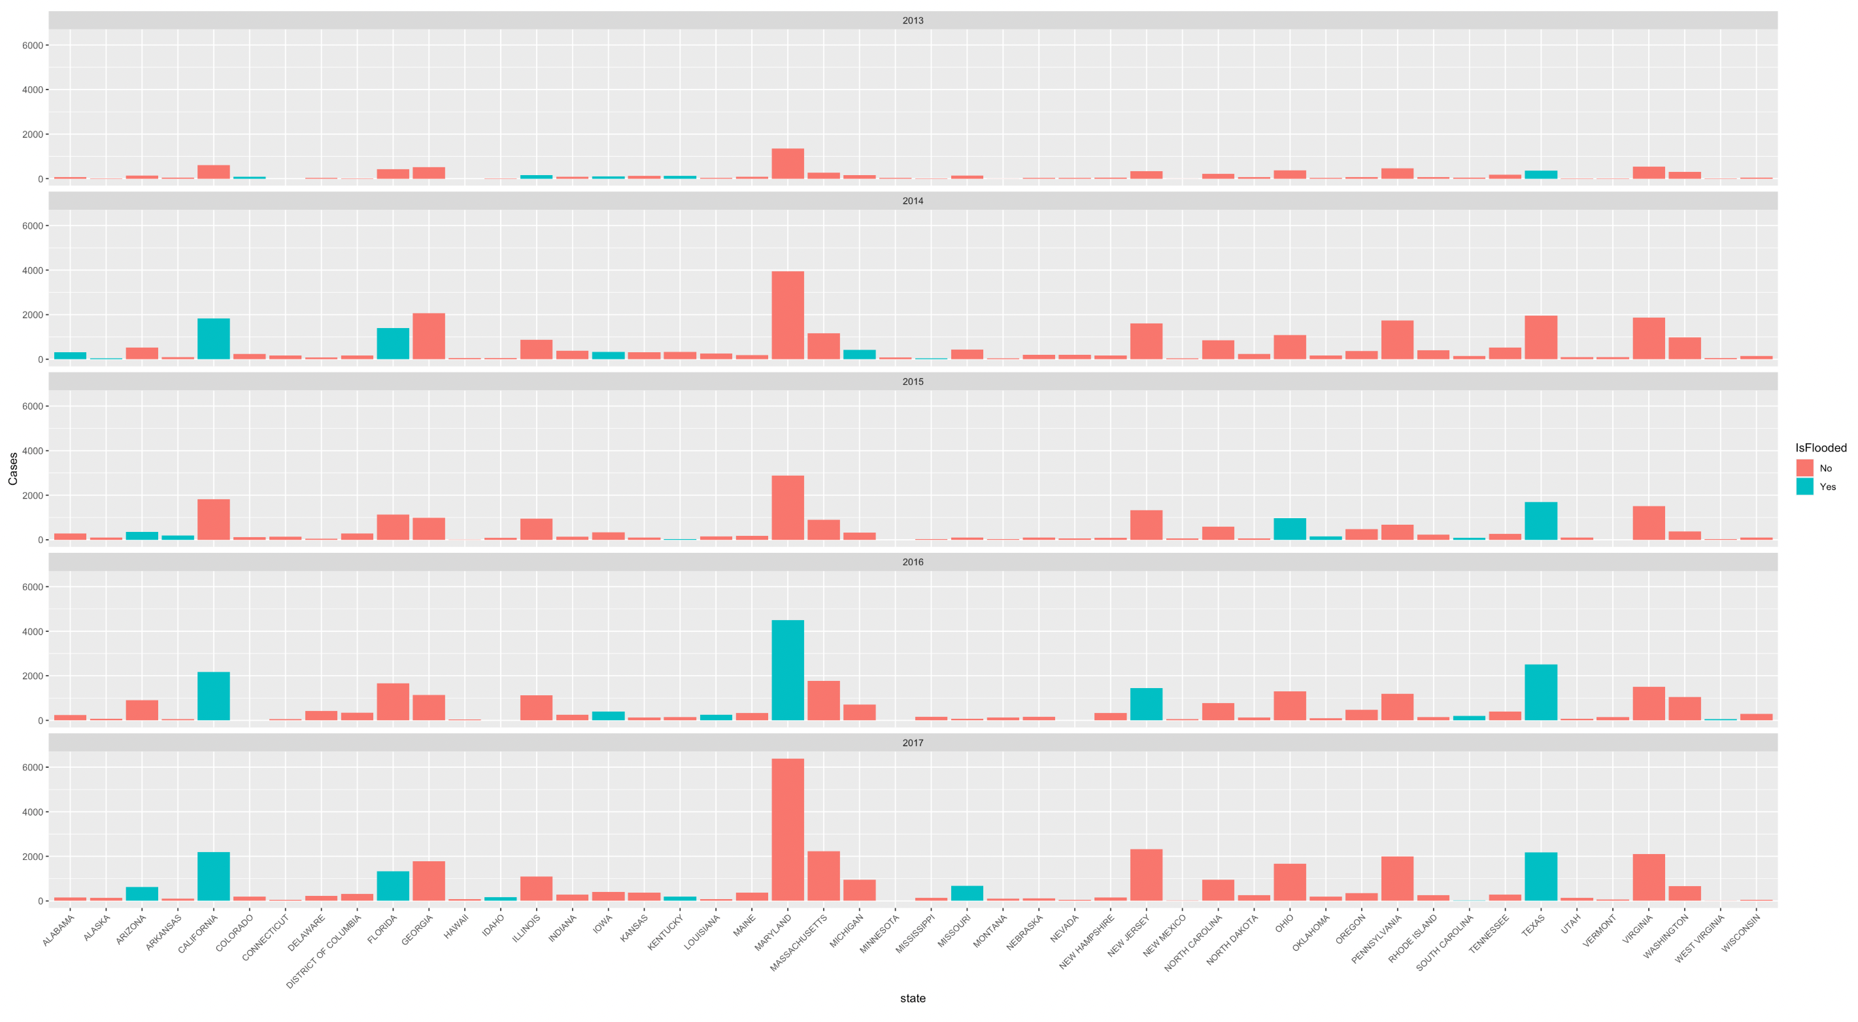
Malaria

Slide 12
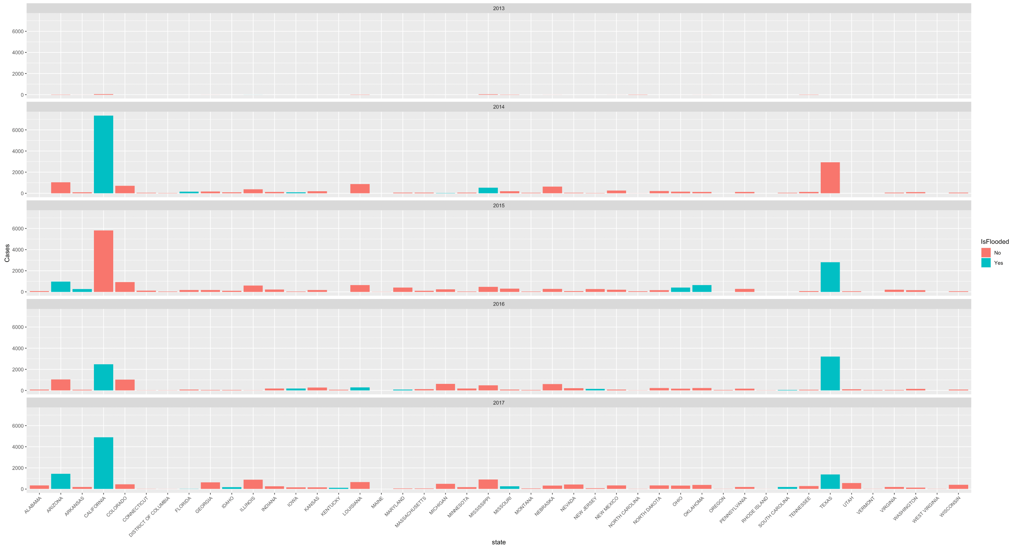
West Nile Virus

Slide 13
Observations
We can see that in 2015 there is no proof of floods in CA hence there are less number of Dengue cases. But in the next year 2016 CA was recorded with highest number of Dengue cases and also there is an indication that flood was occurred.
We can see that due to floods in the year 2016 MD has recorded highest number of cases when due to floods. And in CA there is a clear indication of floods which can relate to the rising number of Malaria cases.
We can see that due to floods in CA and TX there is large number of WNV cases of WNV over the years 2013-2014

Slide 14
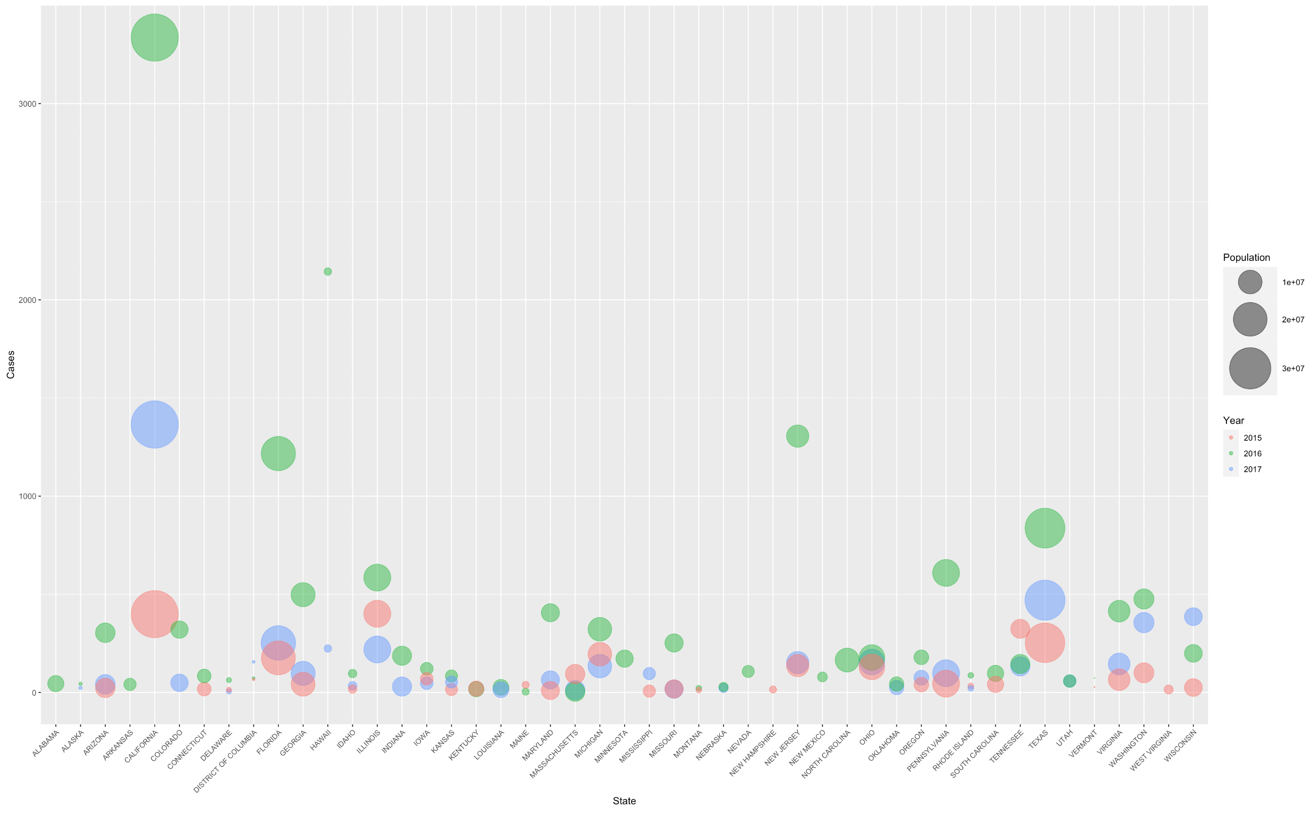
Impact of Population
Dengue

Slide 15
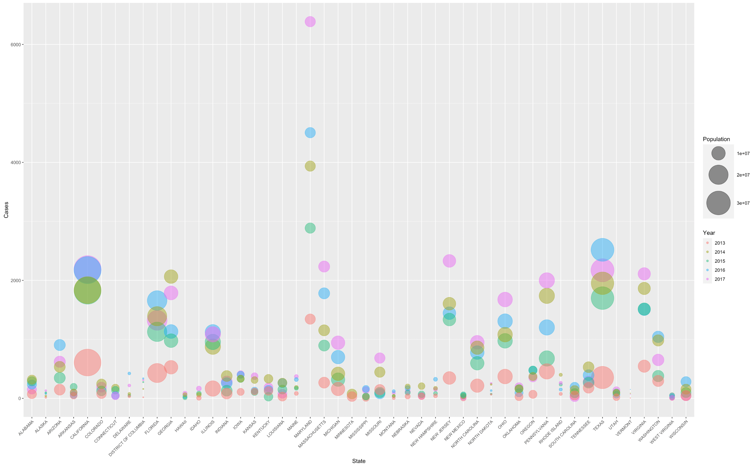
Malaria

Slide 16
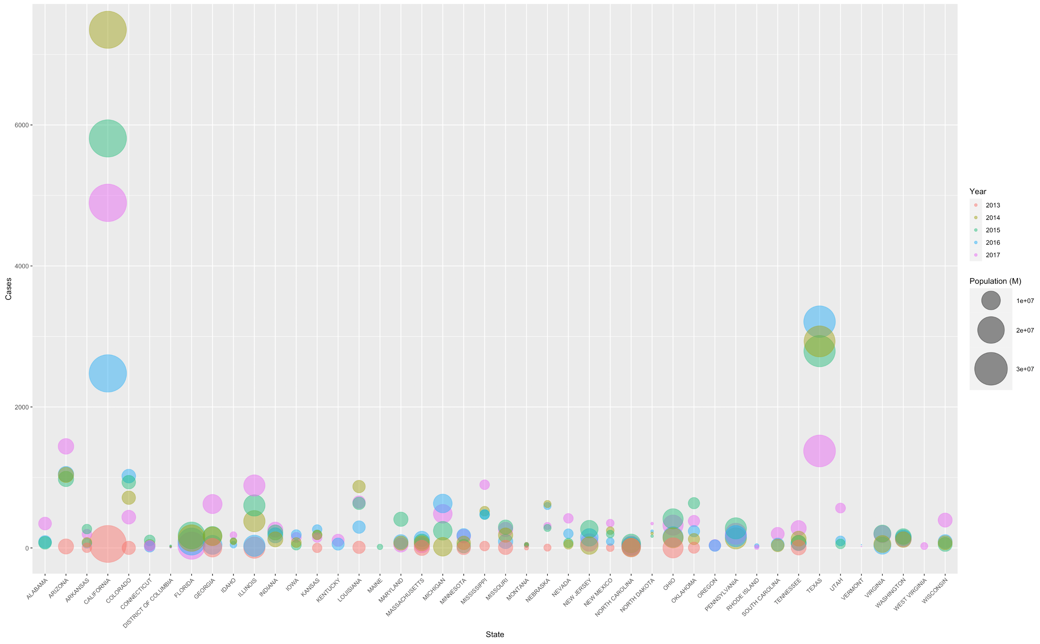
West Nile Virus

Slide 17
Observations
From the three plots we can see that CA and TX has highest population and hence the number of people affected with vector-borne disease is also more.

Slide 18
Conclusion
Although there seems to be a huge correlation between number of vector-borne diseases cases with floods and population but there are some exceptions.
The exceptions maybe due to unavailability of data or there are other factors which will be affecting. More data is required in order to get more accurate correlation and results for future work.

Slide 19
Thank You

